Slide 1
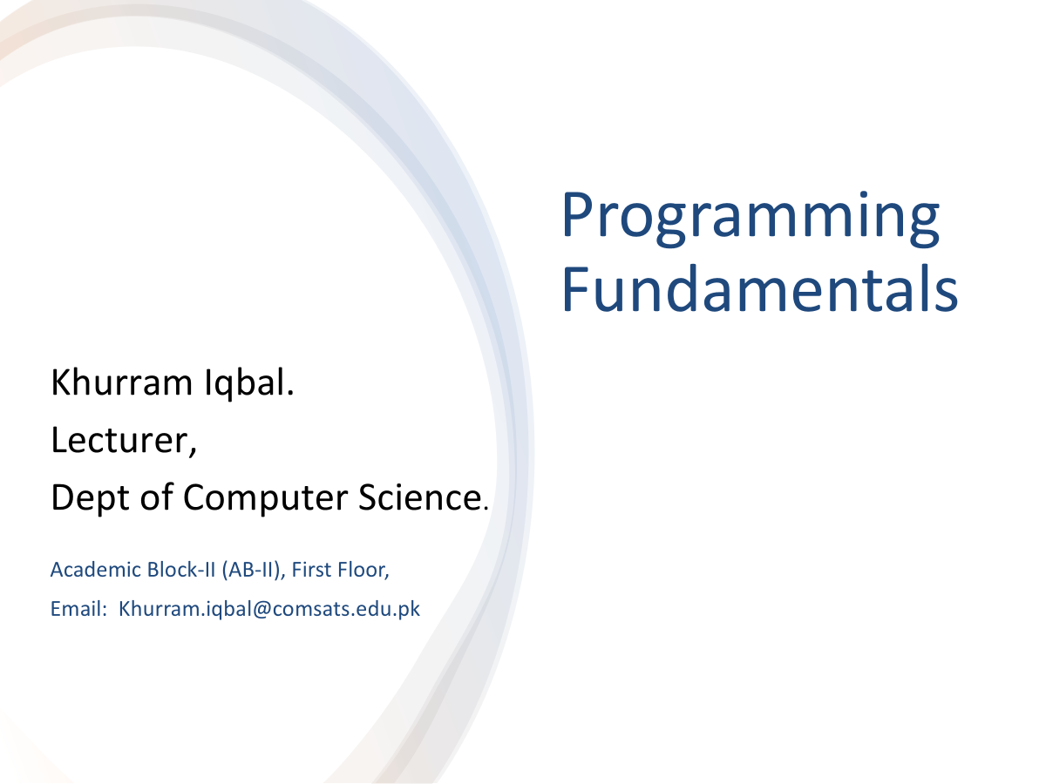

Slide 2
Lecture Outline
Increment/Decrement Operators
Formatted Output

Slide 3
Increment and Decrement Operators
Example – PreIncrement / Predecrement
int i = 3, j = 3;
++i; // i becomes 4
--j; // j becomes 2
The increment operator (++) and decrement operator (– –) are for incrementing and decrementing a variable by 1.
Example – PostIncrement / Postdecrement
int i = 3, j = 3;
i++; // i becomes 4
J--; // j becomes 2

Slide 4
Increment and Decrement Operators

Slide 5
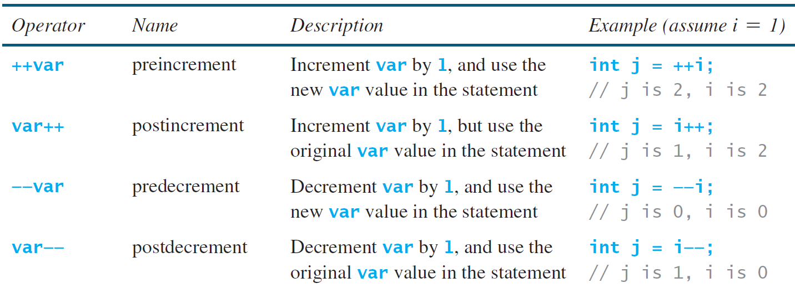
Increment and Decrement Operators

Slide 6
Output of the following Java program?
public class IncrementDecrementTest {
public static void main(String[] args) {
int i = 5;
int result = ++i + i--;
System.out.println("Result: " + result);
System.out.println("Final value of i: " + i);
}
}

Slide 7
Output of the following Java program?
public class IncrementDecrementTest {
public static void main(String[] args) {
int i = 5;
int result = ++i + i-- + i++ + --i;
System.out.println("Result: " + result);
System.out.println("Final value of i: " + i);
}
}
A) Result: 22, Final value of i: 5 B) Result: 21, Final value of i: 5 C) Result: 22, Final value of i: 6 D) Result: 20, Final value of i: 4

Slide 8
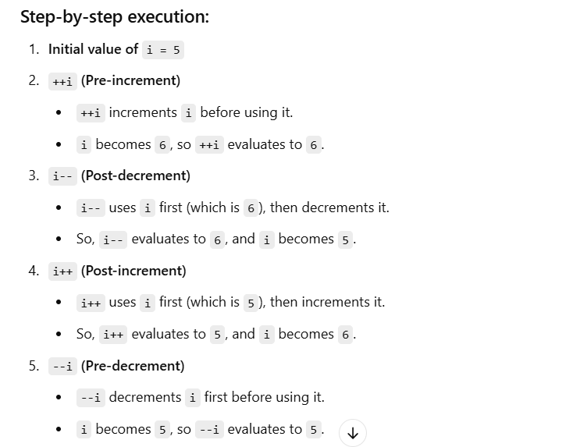

Slide 9

Character Data Type
Computers use binary numbers internally
Mapping a character to its binary representation is called encoding
How characters are encoded is defined by an encoding scheme
Java supports Unicode (16 bit character encoding and 65,536 characters are possible)
A 16-bit Unicode takes two bytes
Preceded by \u, expressed in four hexadecimal digits
i.e. ranges from \u0000 To \uFFFF

Slide 10
ASCII Code for Commonly Used Characters
Unicode includes ASCII code with \u0000 to \u007F corresponding to the 128 ASCII characters

Slide 11
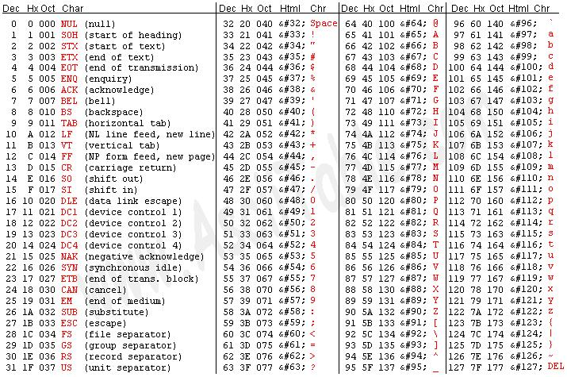
ASCII Table

Slide 12
Character Data Type
Four hexadecimal digits.
char letter = 'A'; (ASCII)
char numChar = '4'; (ASCII)
char letter = '\u0041'; (Unicode)
char numChar = '\u0034'; (Unicode)
NOTE: The increment and decrement operators can also be used on char variables to get the next or preceding Unicode character. For example, the following statements display character b.
char ch = 'a';
System.out.println(++ch);

Slide 13
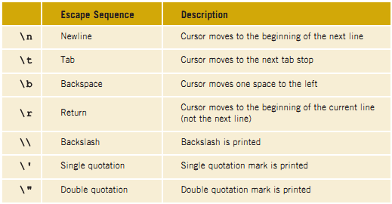
Escape Sequences for Special Characters

Slide 14
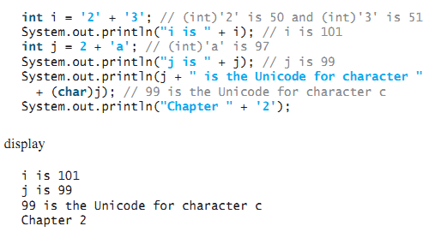
Casting between char and Numeric Types
int i = 'a'; // Same as int i = (int)'a';
char c = 97; // Same as char c = (char)97;
char ch = (char)65.25; // Decimal 65 is assigned to ch
System.out.println(ch); // ch is character A
All numeric operators can be applied to char operands

Slide 15
Formatting Console Output
You can use the System.out.printf method to display formatted output on the console.
Syntax
System.out.printf(format, item1, item2,..., itemk);
Where format is a string that may consist of substrings and format specifier.
A format specifier specifies how an item should be displayed.
An item may be a numeric value, character, boolean value, or a string.
Items must match the format specifier in order, in number, and in exact type
A simple format specifier consists of a percent sign (%) followed by a conversion code e.g. (%d ).

Slide 16
Frequently-Used Specifiers
Specifier Output Example
%b a boolean value true or false
%c a character 'a'
%d a decimal integer 200
%f a floating-point number 45.460000
%e a number in standard scientific notation 4.556000e+01
%s a string "Java is cool"

Slide 17


Formatting Console Output
%4.2f is a format specifier:
% indicates format conversion.
4 represents the minimum width.
.2f ensures that the output is rounded to 2 decimal places.
The floating-point result 16.444674 is rounded to 16.44 to match the .2f format.

Slide 18
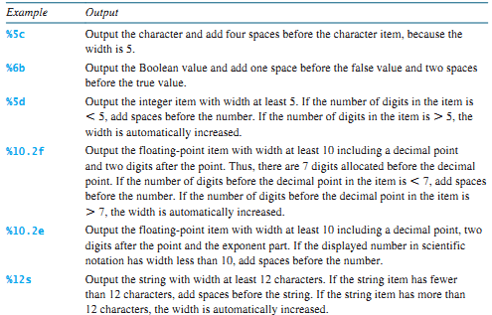
Width and Precision in Format Specifier

Slide 19
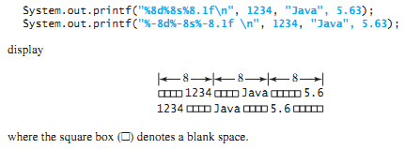
Example

Slide 20
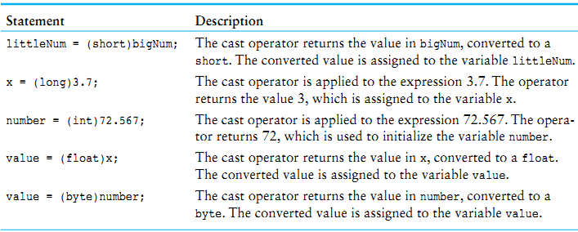
The cast operator lets you manually convert a value
Cast Operators

